Slide 1
SMART AS
F*CK TRASH CAN
Vividh Arcot Velan, Binh Vu, Pablo Garcia Guo
BFF

Slide 2
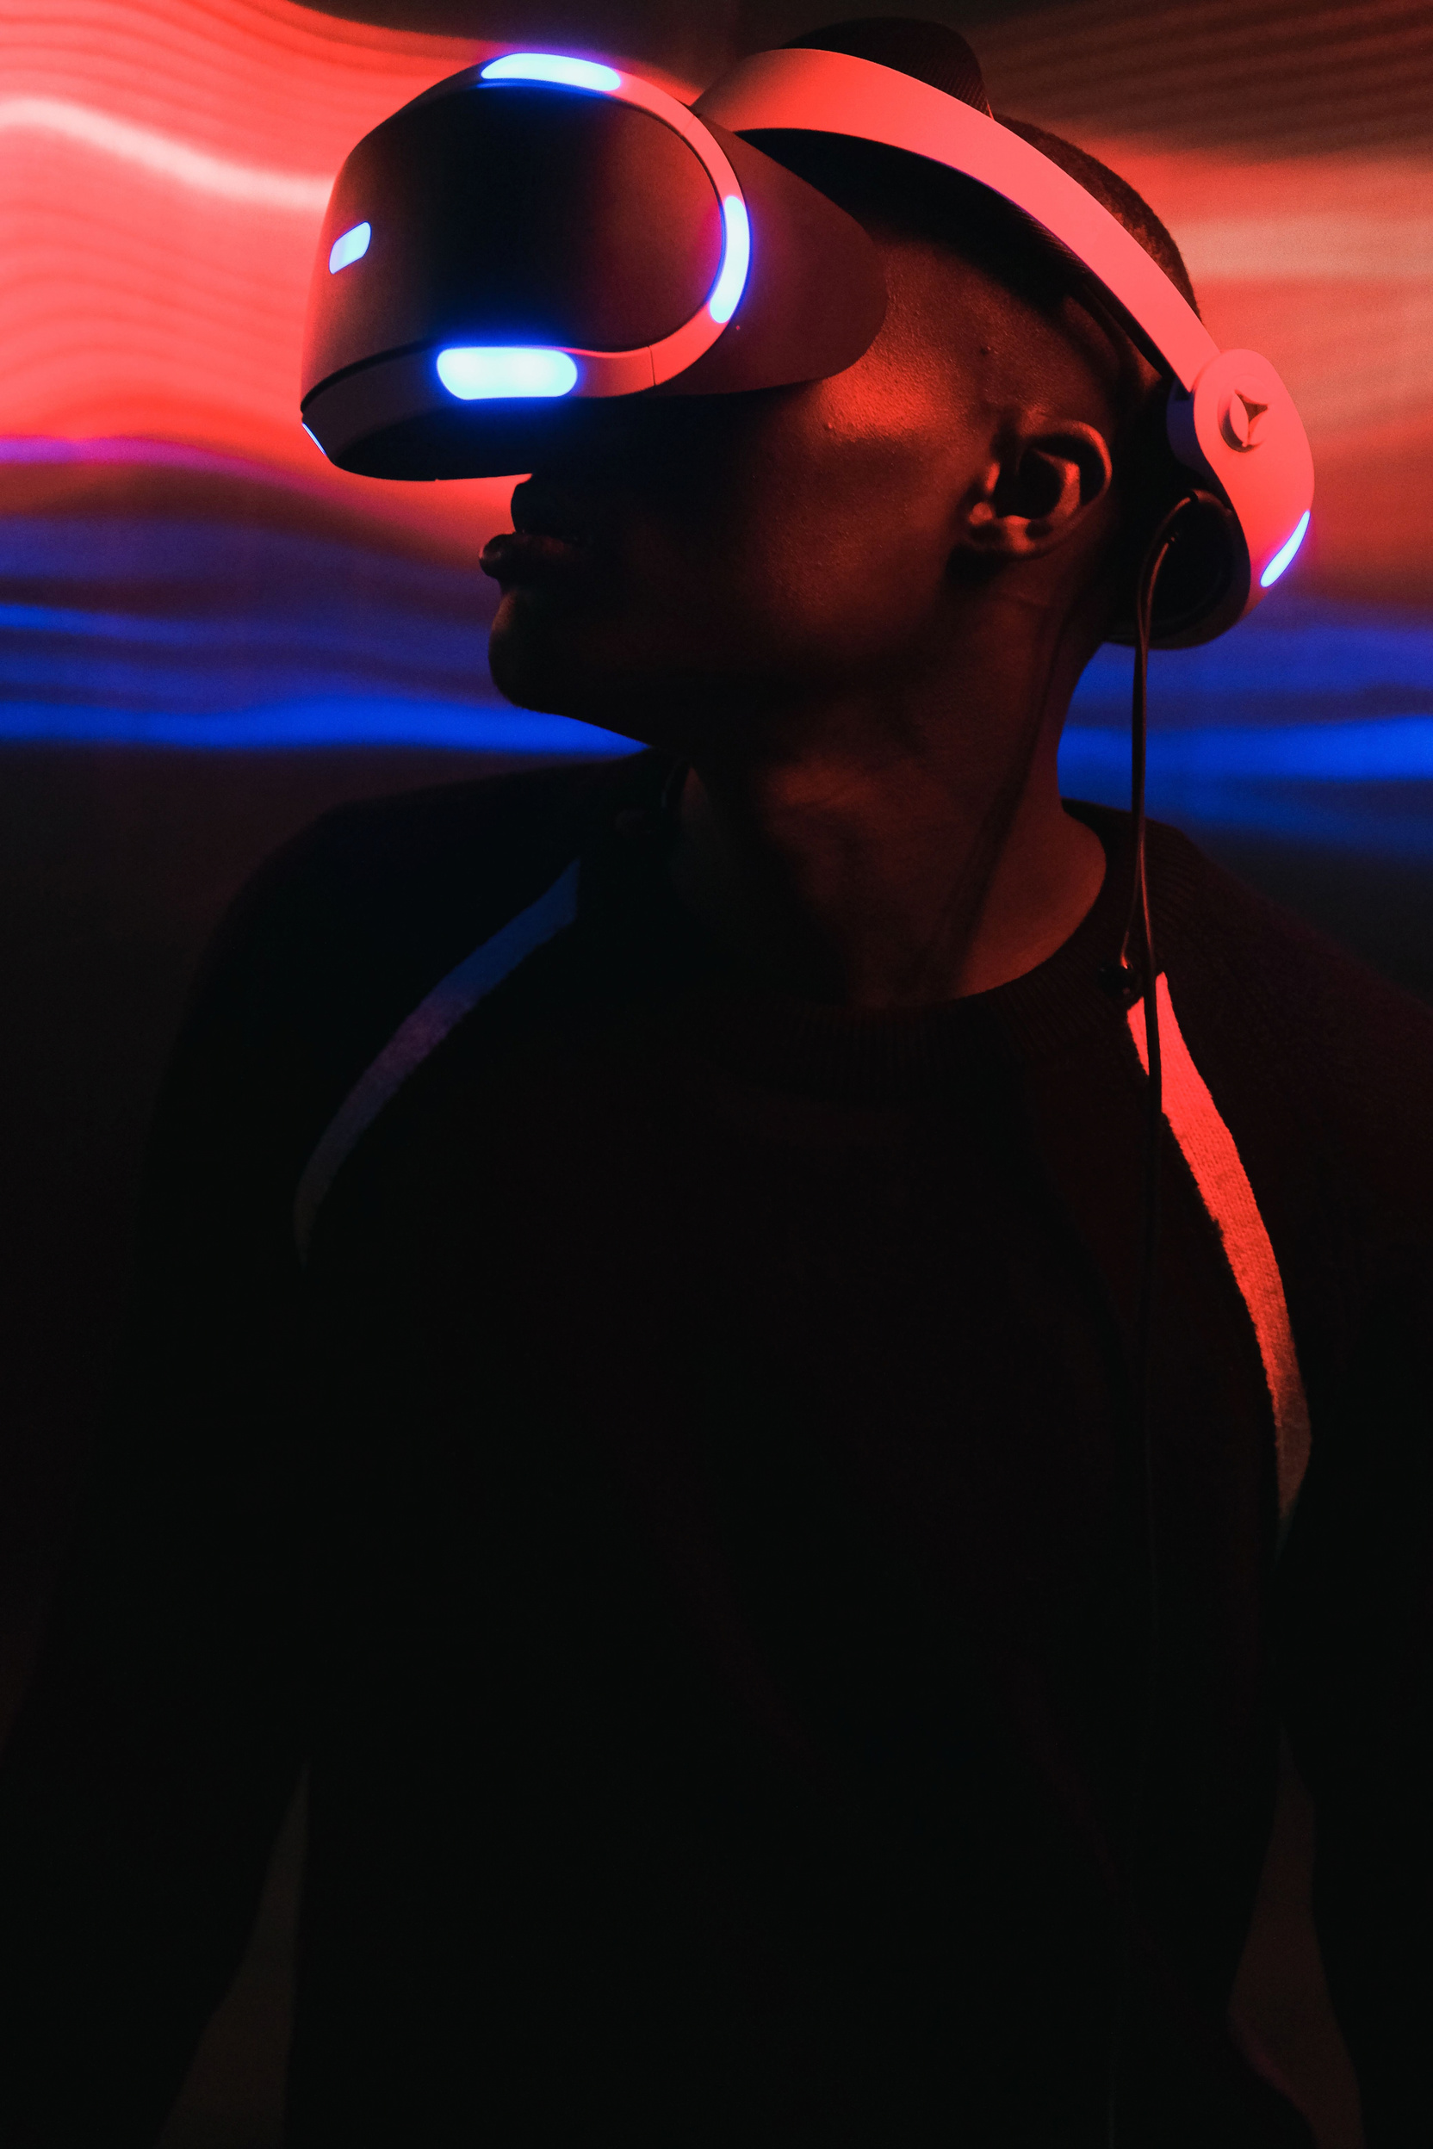
MEET THE TEAM
VIVIDH
PABLO
JURICUMO
BFF

Slide 3
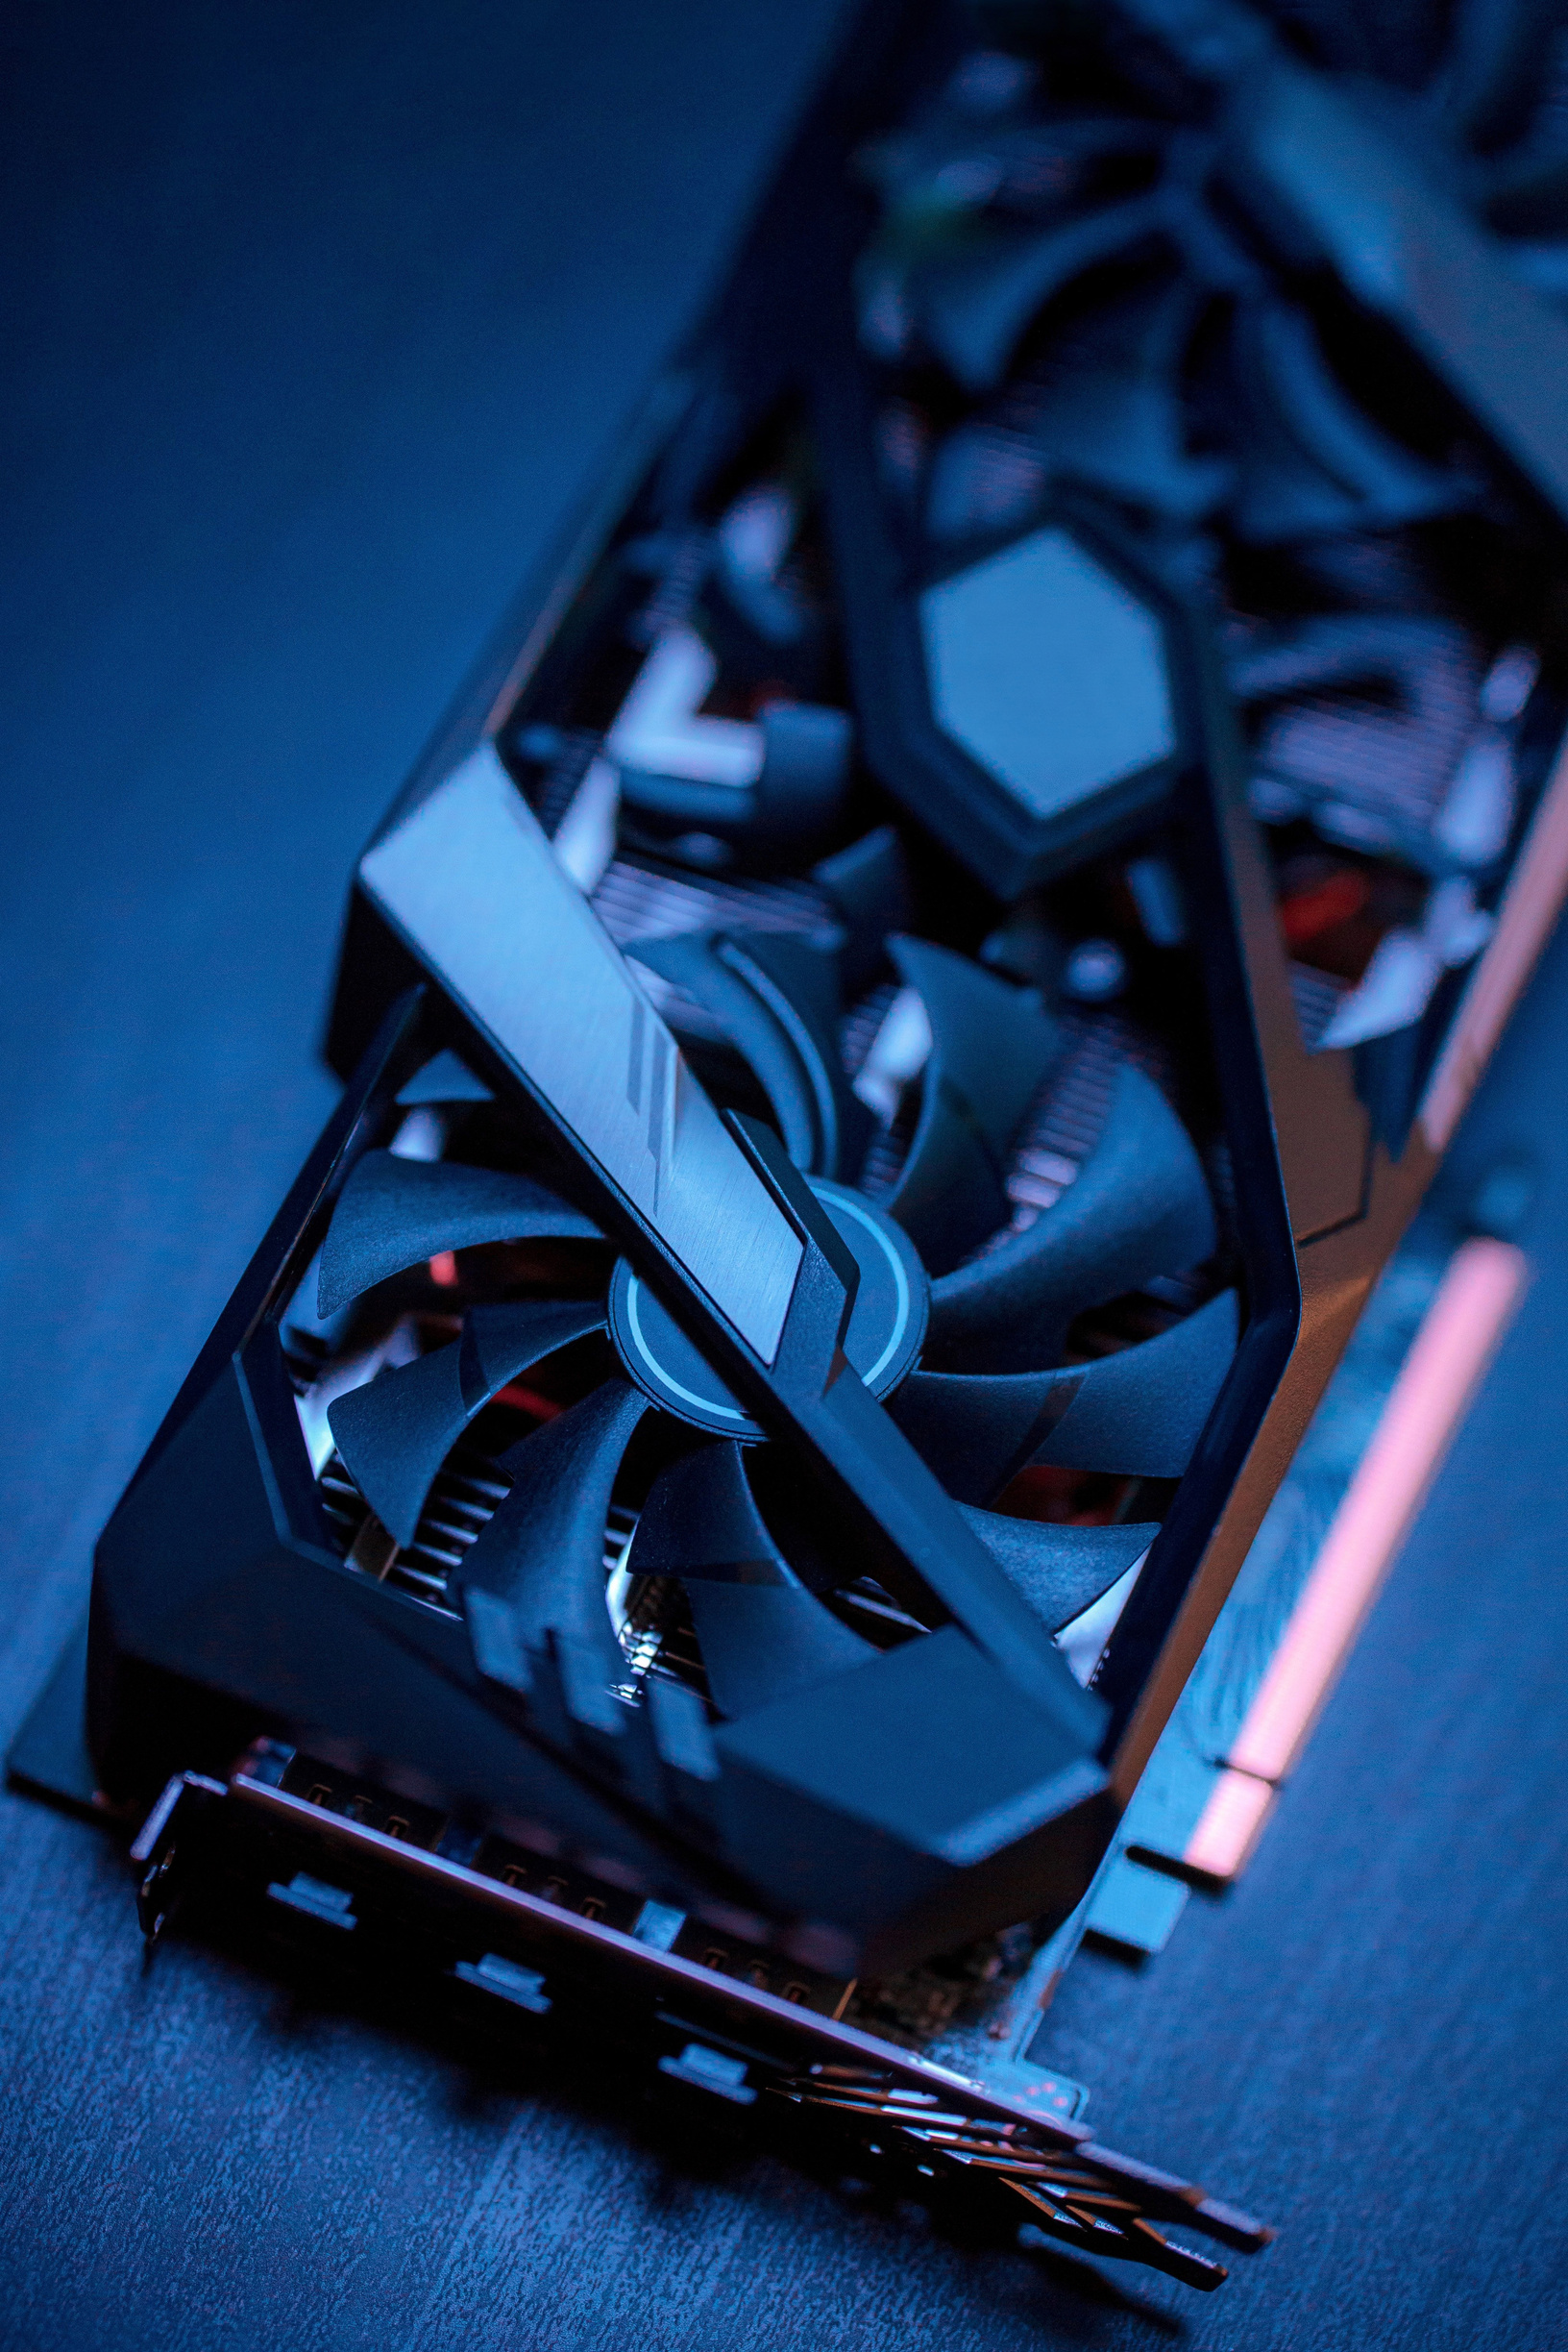
THE MISSION:
BRINGING TRASH TO THE NEXT LEVEL
  Trash cans get your hands dirty
  We will solve that
  Here we innovate
BFF

Slide 4
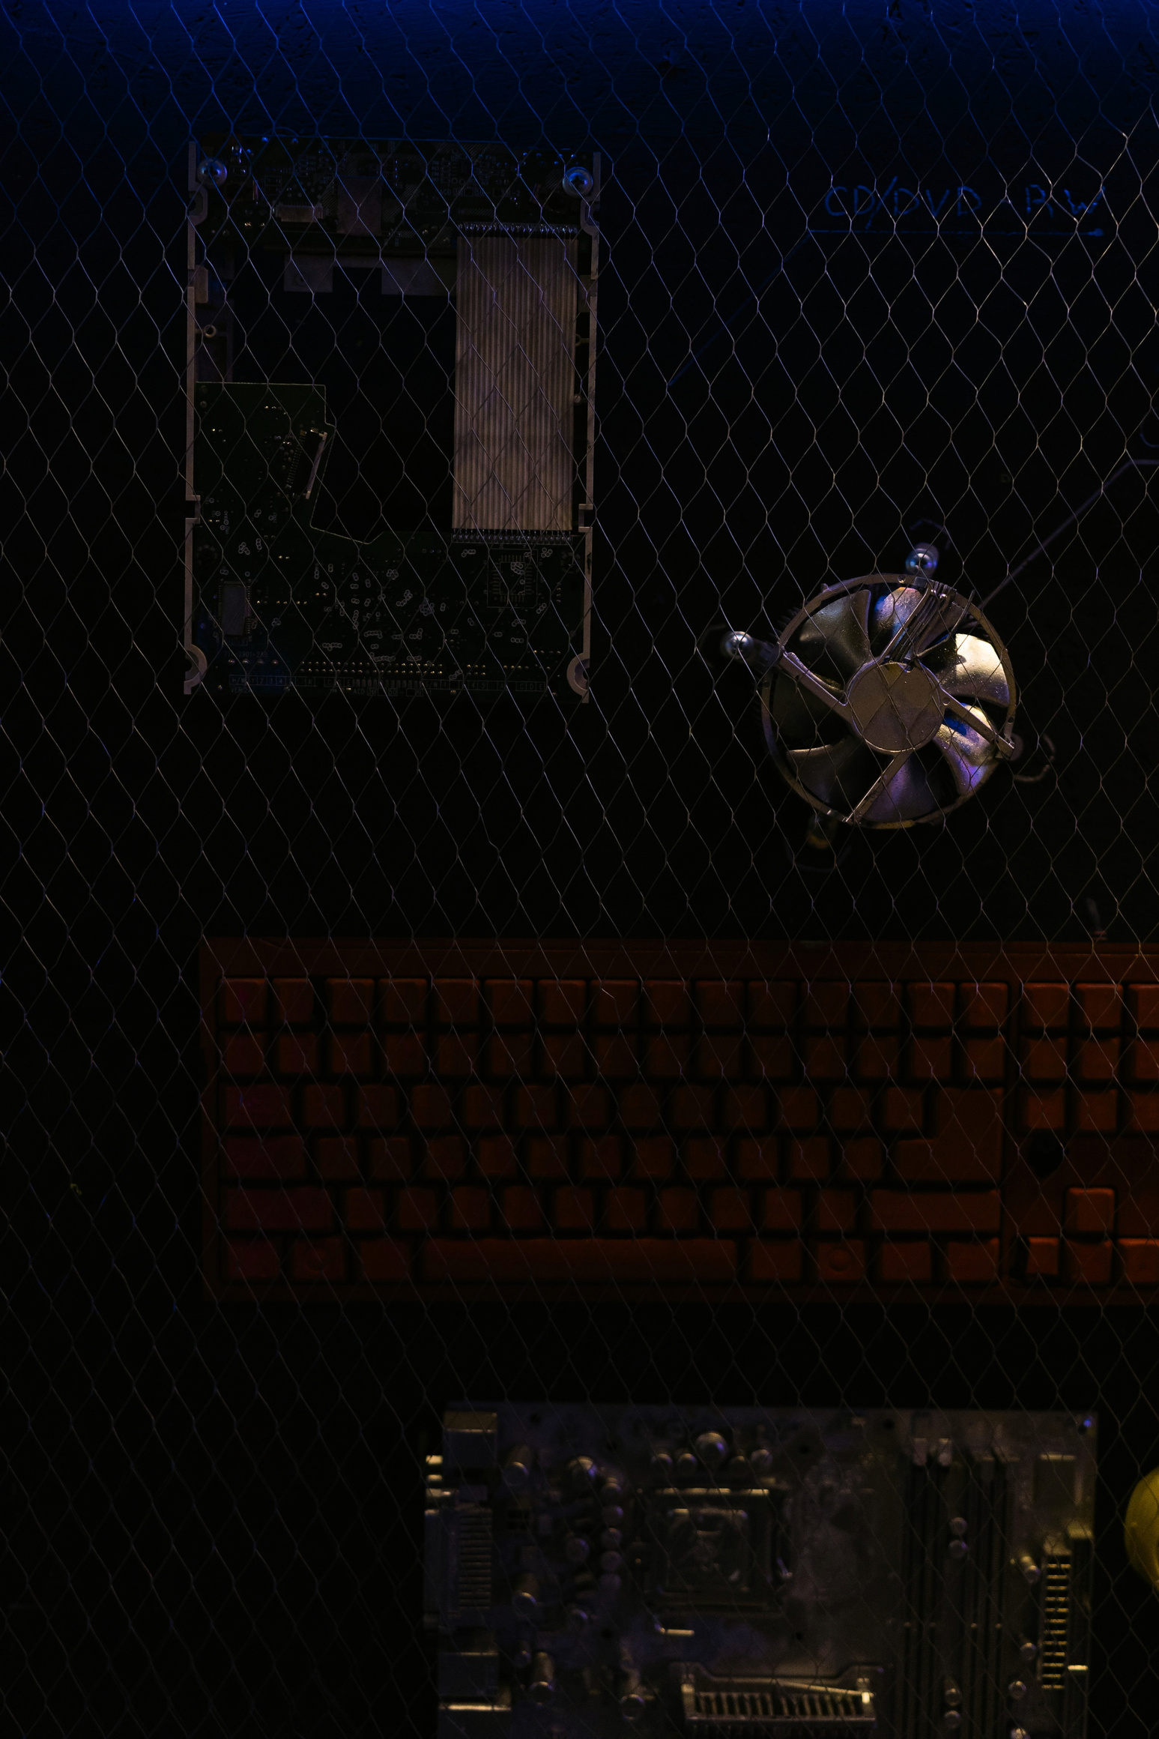
THE PROCESS
  Innovation at JHC
  Intense work
  Design
BFF

Slide 5
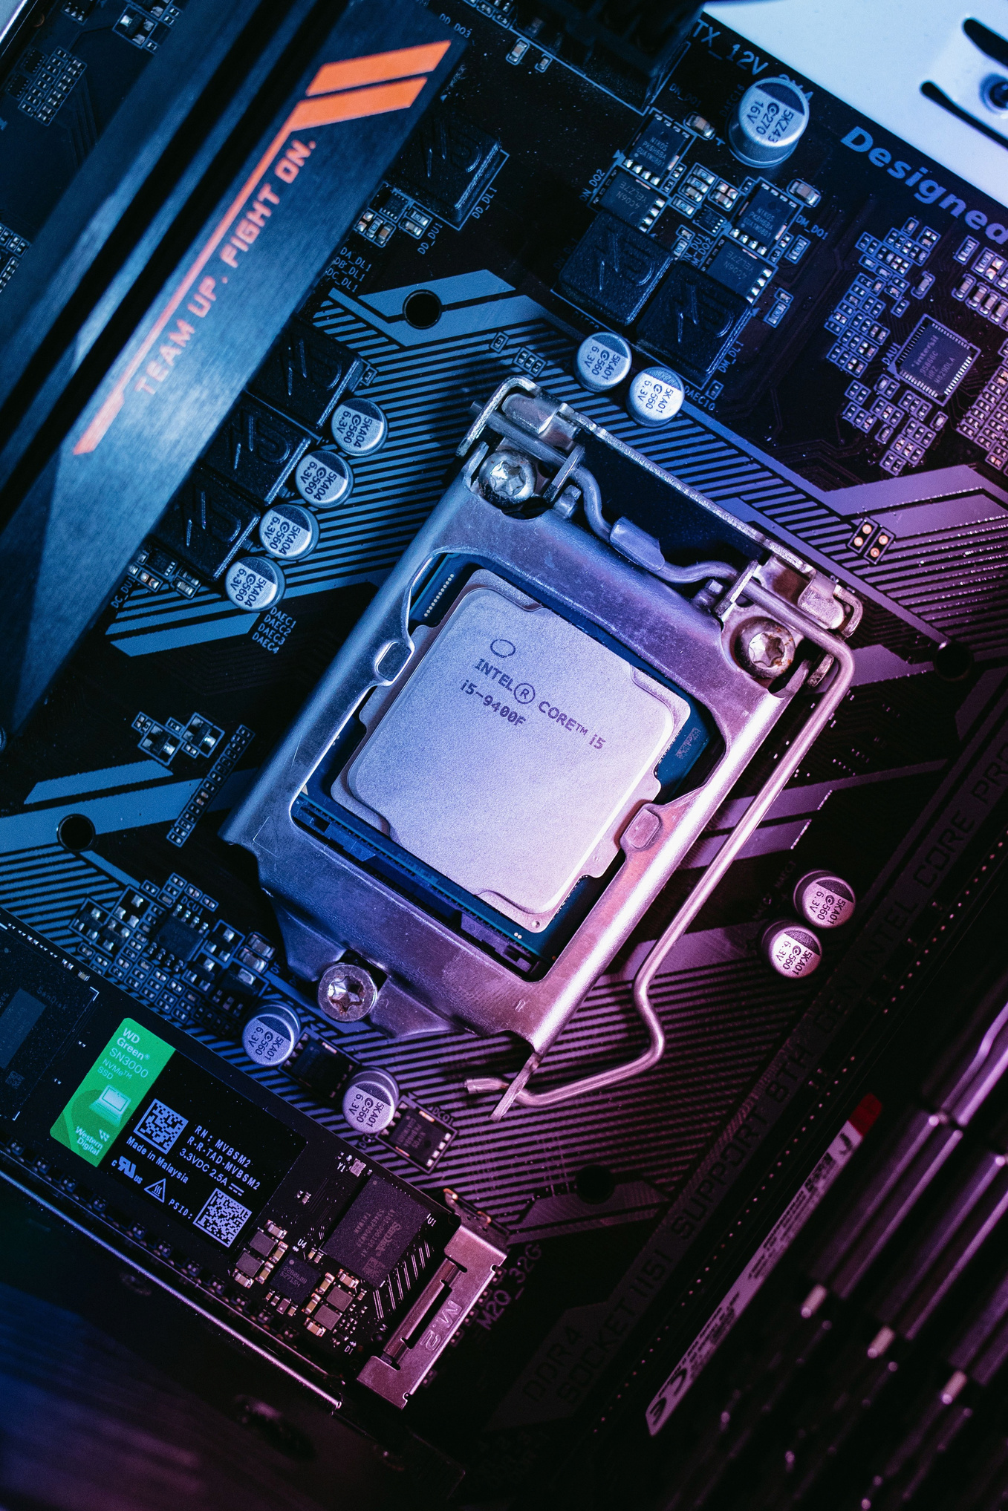
THE PIVOT
  Downsized the trash can
  Re-did the wiring
  It works now
BFF

Slide 6
THANK YOU
BFF

